Slide 1
SMART INVENTORY LEVEL SYSTEM
MIGUEL LOPEZ

Slide 2
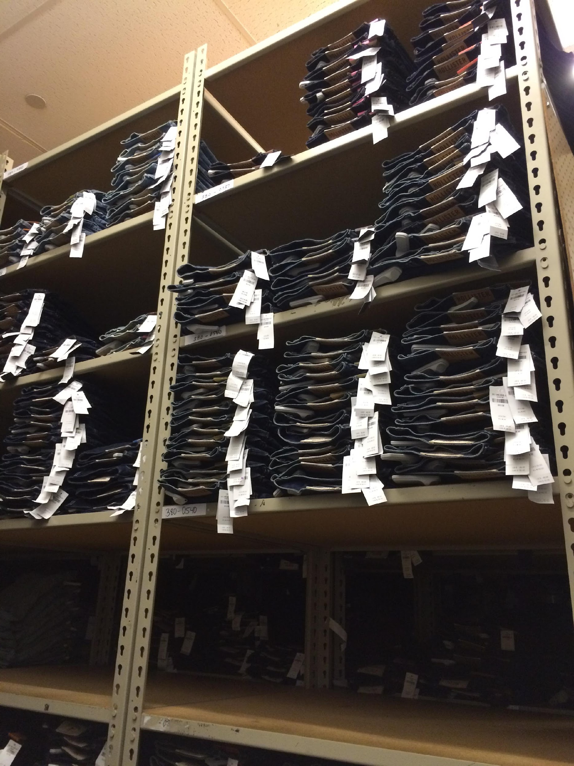
PROBLEM?
Retail Store environment
Stockroom inventory levels fluctuate daily
Inbound shipment units must be monitored manually
Help coordinate stockroom management efforts

Slide 3
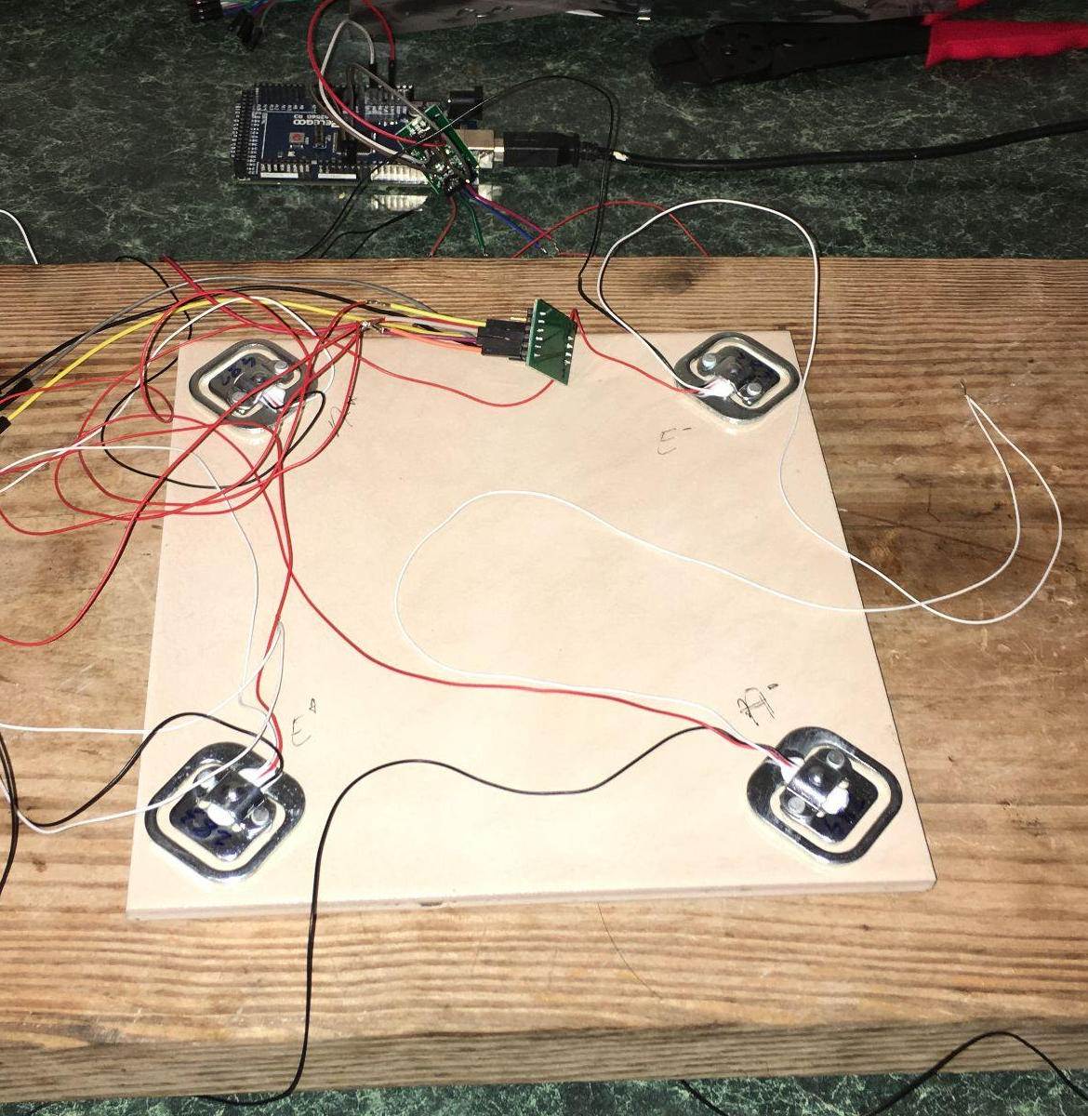
SYSTEM DESIGN
Track each shelf with weight sensors
Report to main system at beginning of day
Visualize and log data

Slide 4
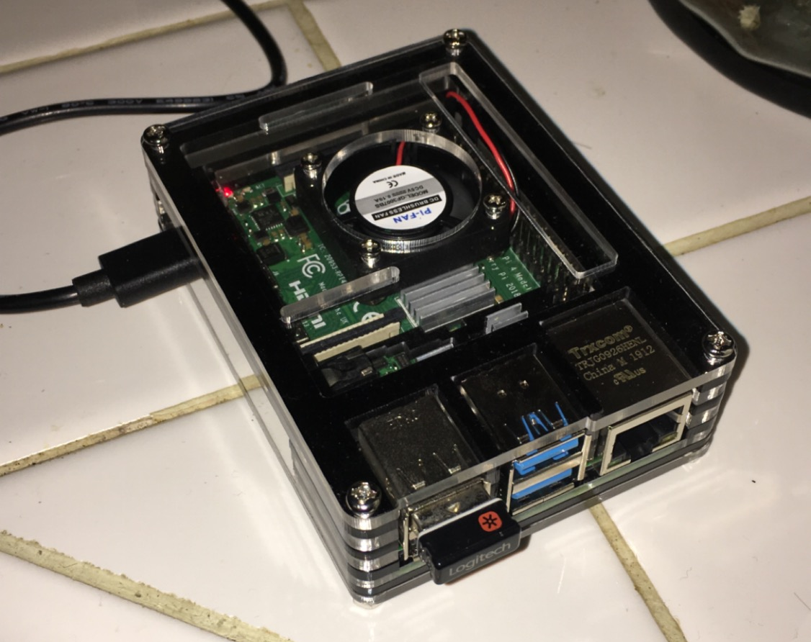
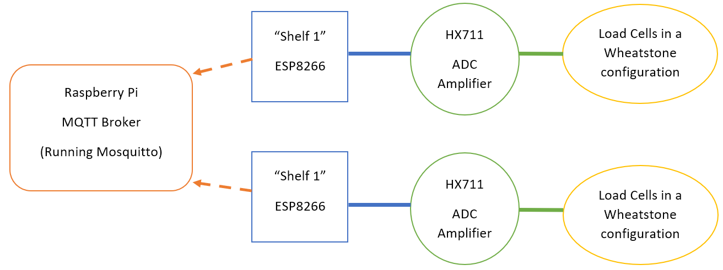
SYSTEM DIAGRAM

Slide 5
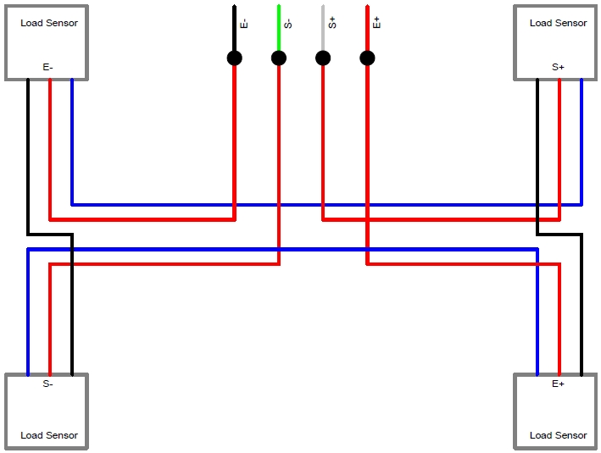
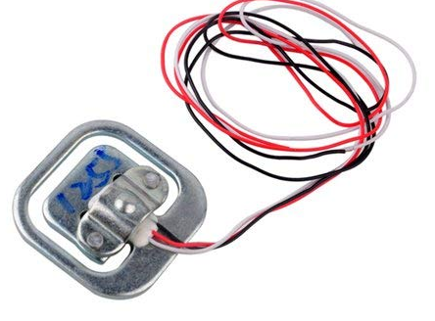
LOAD CELLS
3 Wire load cells
50kg each
200kg = about 440 lbs.

Slide 6
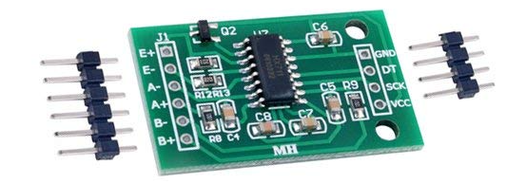
MODULE - MCU - MICROCOMPUTER
HX711
Amplify the analog signals
Connected through data pin and clock
ESP8266
Wifi microcontroller
Raspberry Pi
Mosquitto -> Node-Red -> InfluxDB -> Grafana

Slide 7
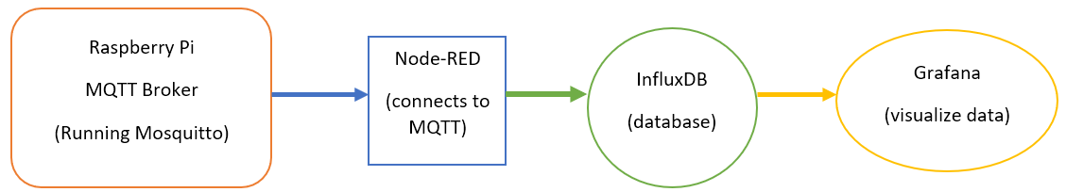
FLOW CHART OF DATA
All software running on the Raspberry Pi

Slide 8
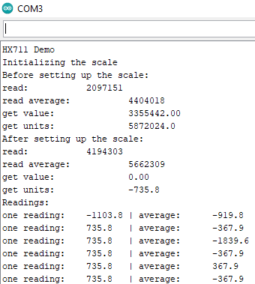
TROUBLES
HX711 system was not reliable
Tried multiple example codes, became confusing fast
Fault in module? Fault in 1 sensor? 2 sensors?
# of sensors used determine wiring layout

Slide 9
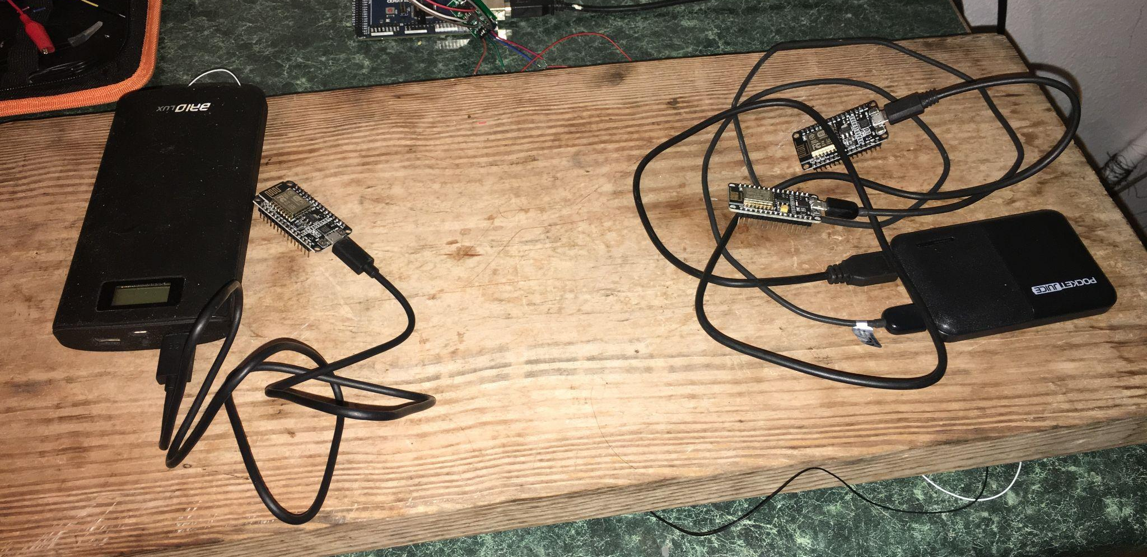
COMPROMISES
Simulated results of HX711/weight sensors
No touchscreen display for manual control
No automatic visualization

Slide 10
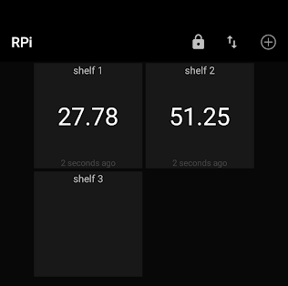
FUTURE TINKERING
Get HX711 working, apply to different projects?
MQTT dashboard/control from android?
Some functional level of the touchscreen display
Alternative MQTT broker?
Hosted on android or traditional x86/x64 Linux | Windows

Slide 11
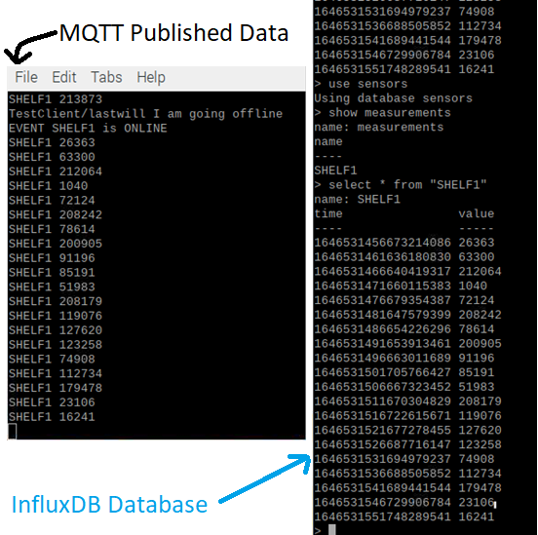
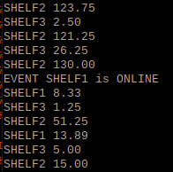
Mosquitto
MQTT subscription messages being stored by NodeRed and stored into an InfluxDB database

Slide 12
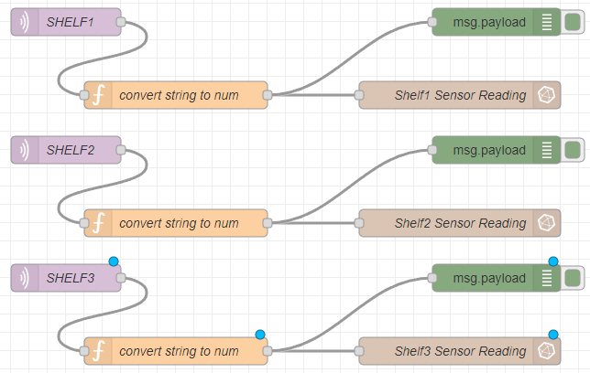
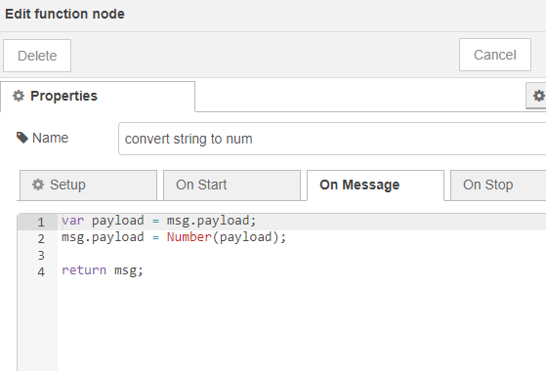
Node-RED
Converting string to num in NodeRed, to then store into InfluxDB, and read as nums and not string by Grafana

Slide 13
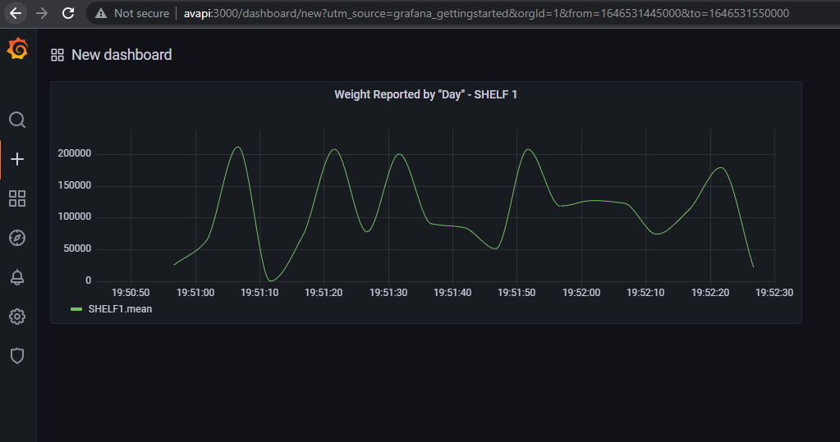
Grafana
Short Live Demo

